Slide 1


Slide 2
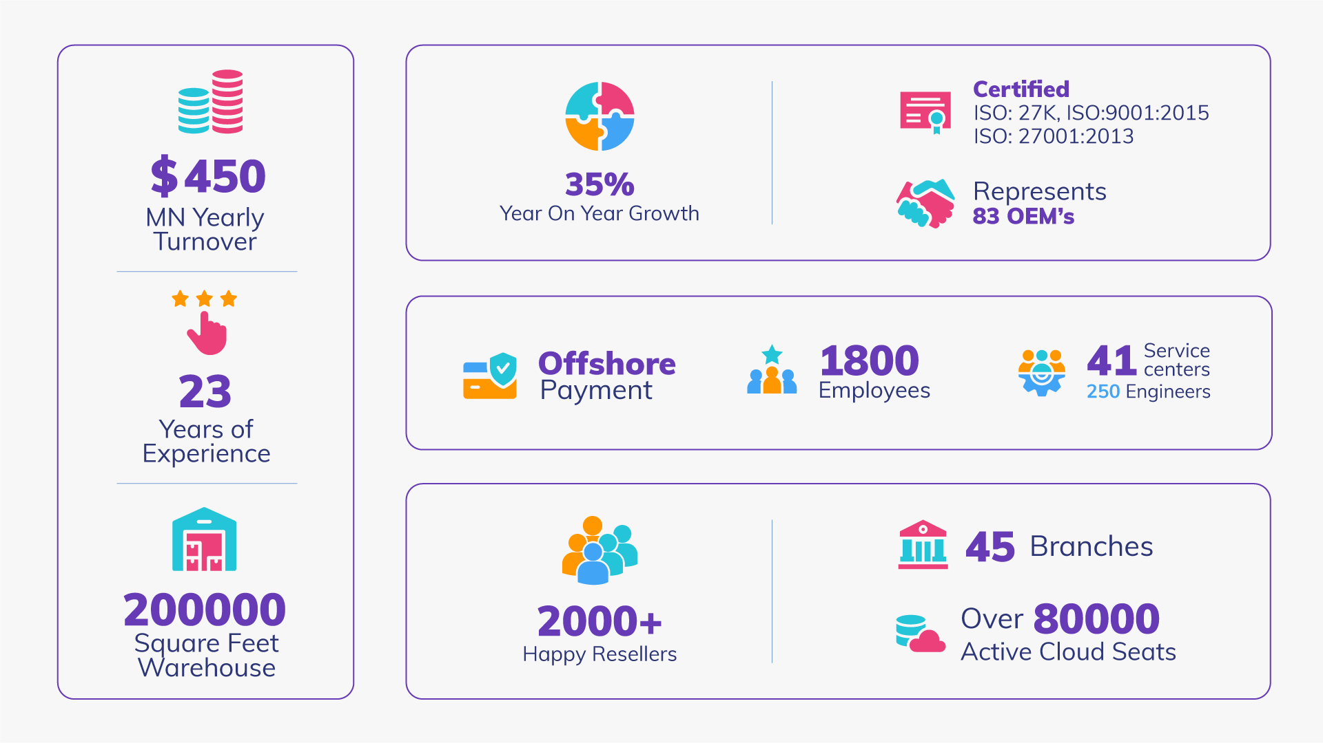

Slide 3

Timeline
COMPANY JOURNEY

Slide 4
TIMELINE
UNISOFT
Smart Electronics Ltd
1998
2001
2005
2000
2004
Smart Technologies (BD) Ltd
Established
Digital Equipment
Global Office Automation Limited

Slide 5
TIMELINE
Smart Printing Solution Ltd
1000FiX Services Ltd.
Smart Foundation
2015
2019
2014
2017
2021
FRESCO EME LIMITED
Ship-Smart Data Technology (Bangladesh) Co. Limited

Slide 6

GEOGRAPHICAL COVERAGE

Slide 7
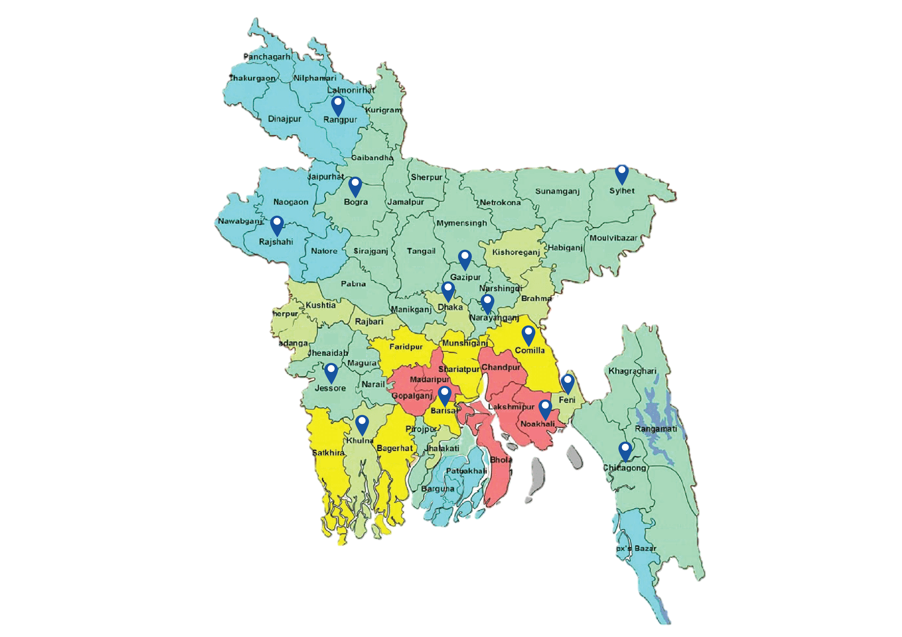
NATIONAL
PRESENCE
BANGLADESH

Slide 8


GLOBAL PRESENCE
UAE
Bangladesh
Singapore

Slide 9

OUR SOLUTIONS & BRANDS
SMART is an authorized and exclusive distributor for a number of top vendors, allowing us to be the first to market with the most cutting-edge technology and concepts.

Slide 10
CLOUD COMPUTING
IOT & HYBRID CLOUD SOLUTION
SOFTWARE SOLUTION
10
09
01
COMPUTER COMPONENTS
NETWORKING PERIPHERALS
08
02
07
03
MONITORS & PROJECTORS
06
04
PRINTING SOLUTION & PERIPHERALS
05
MULTIMEDIA / GAMES
CYBER SECURITY
MOBILITY & TELECOM

Slide 11
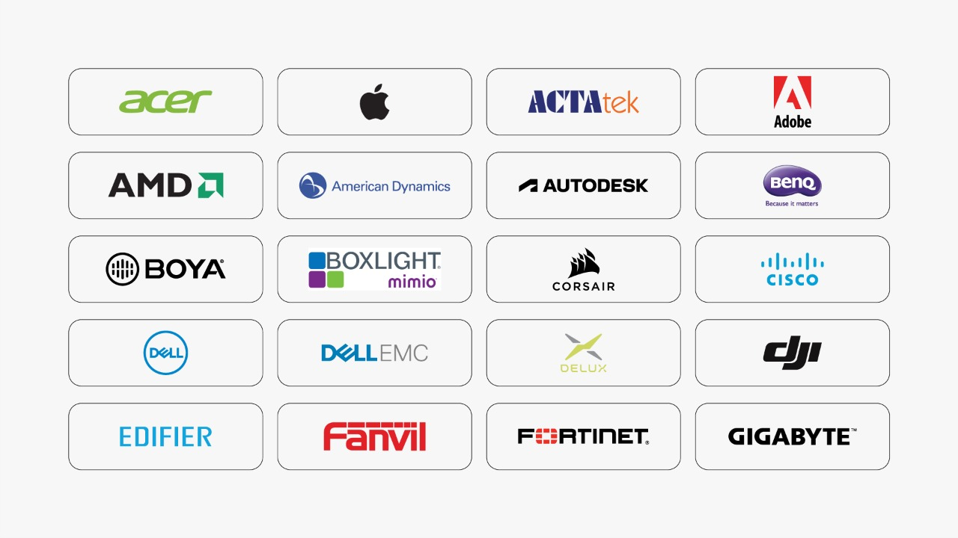

Slide 12
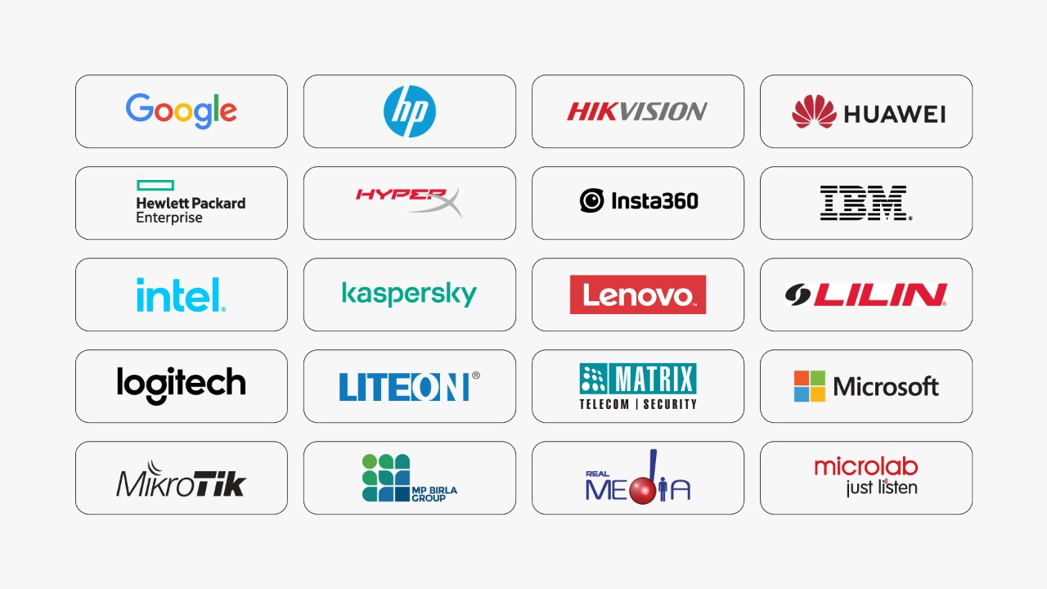

Slide 13
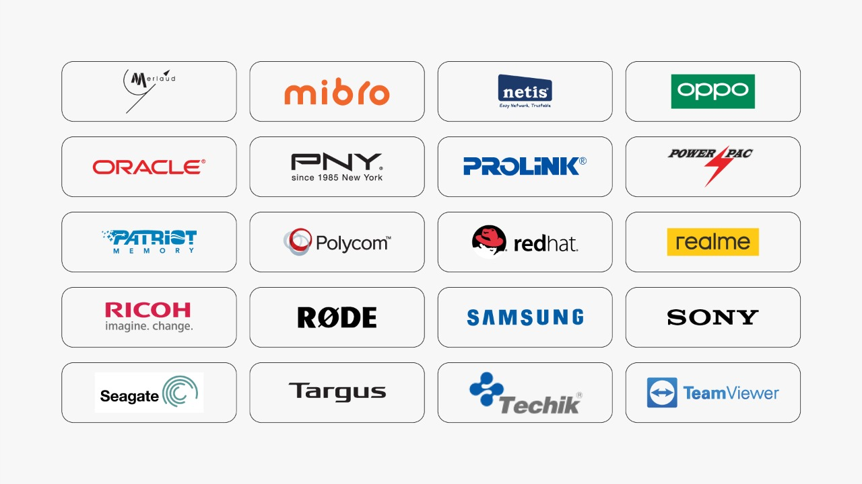

Slide 14
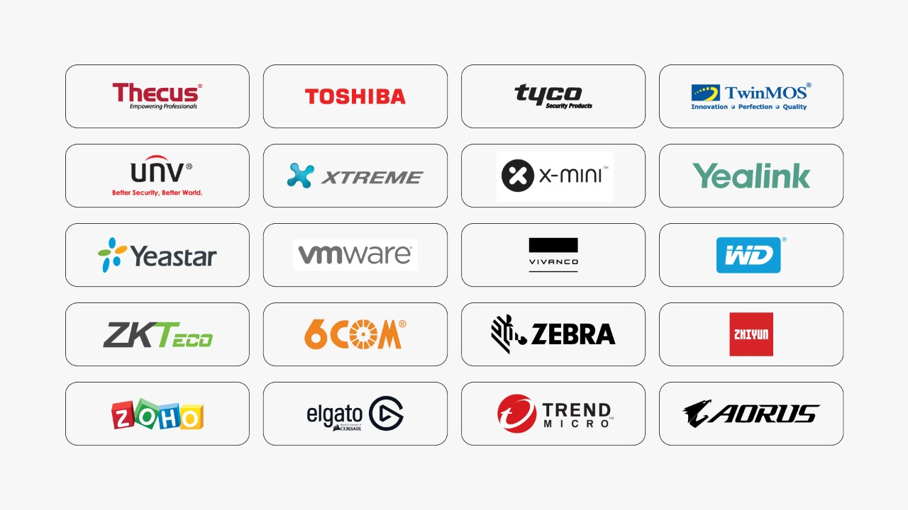

Slide 15

DISTRIBUTION
65%
RETAIL
5%
PRIVATE SECTOR
20%
PUBLIC SECTOR
10%

Slide 16

YoY GROWTH

Slide 17
Credit
Flexible credit facilities for channel partners
Eco-System
Advisory
Healthy Channel
Eco-system
Ready Techno Sales & implementation Team
Solutions
Marketing and PR Team
A broad technology offering from more than 100 Global brands
In-house Marketing and PR Team
PARTNER BENEFITS

Slide 18

MARKETING Activities
CREATING OVER 6000+ CONTENTS EVERY YEAR

Slide 19






PRINT MEDIA
DIGITAL
MARKETING
DEDICATED DIGITAL MARKETING TEAM
ANALYTICS
ACTIVATION VS STOCK TURNOVER RATIO
MARKETING
ACTIVITIES
CONSUMER PROMO
Email Marketing
To channel partners and customers with tech update
BEST IN CLASS
PARTNER READINESS
CONTINUOUS ONBOARDING PROCESS

Slide 20






PARTNER READINESS
PARTNER WHITEBOARD
CERTIFICATIONS
ON-SITE SALES TRAINING
TEAM READINESS
DEMAND GENERATION
COMPETENCY
CERTIFICATIONS
ON-SITE TRAINING
EXPERIENCE ZONE
SPIFFs
WEB SYNDICATION
BOOTCAMP
SOCIAL MEDIA
CUSTOMER OFFERS
MARKET DEVELOPMENT
EMAIL BLAST
PRINT ADVERTISING

Slide 21
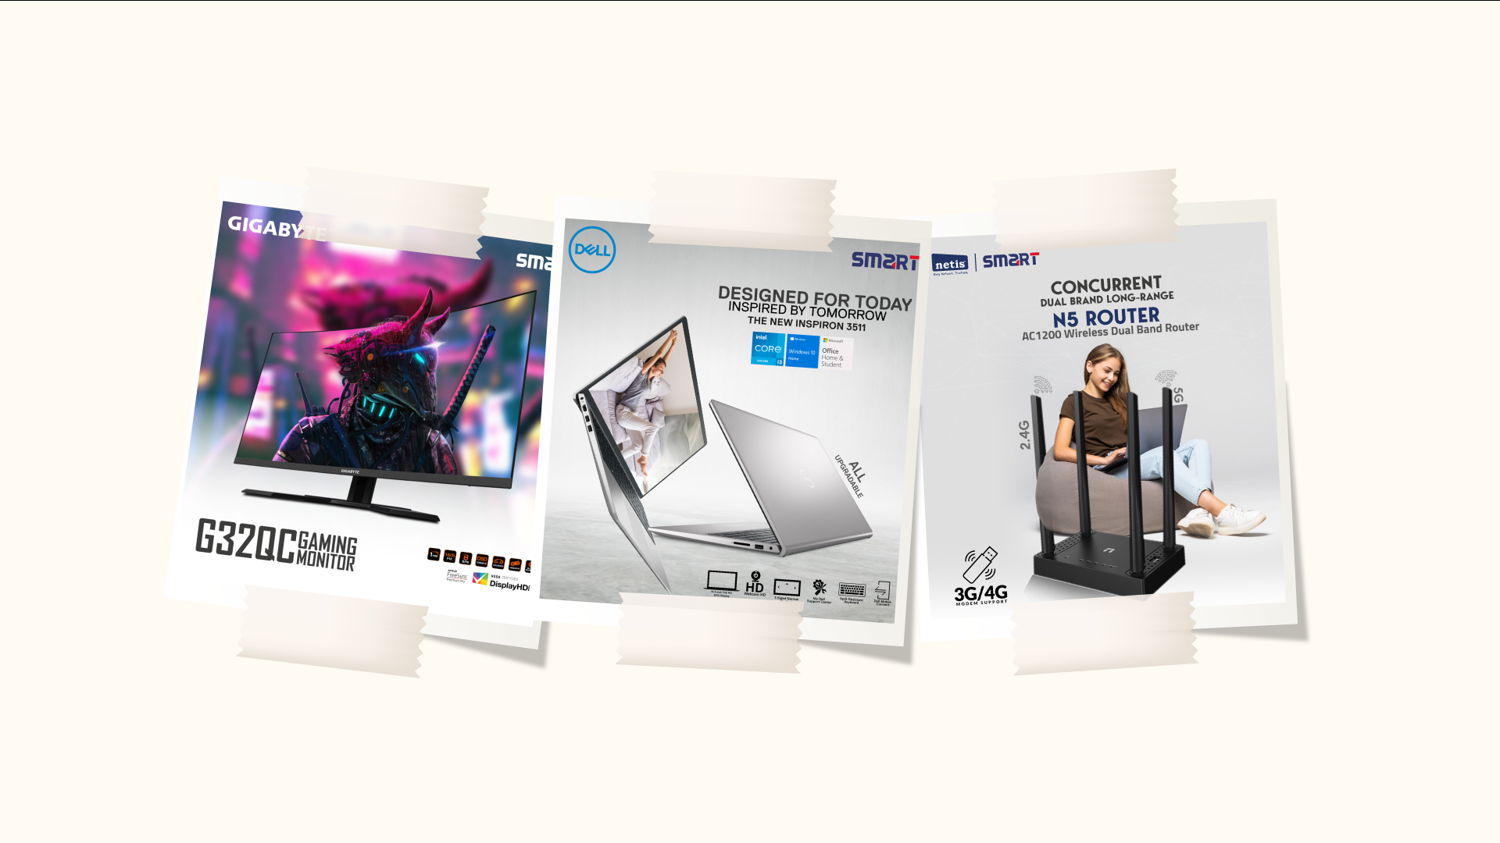

Slide 22
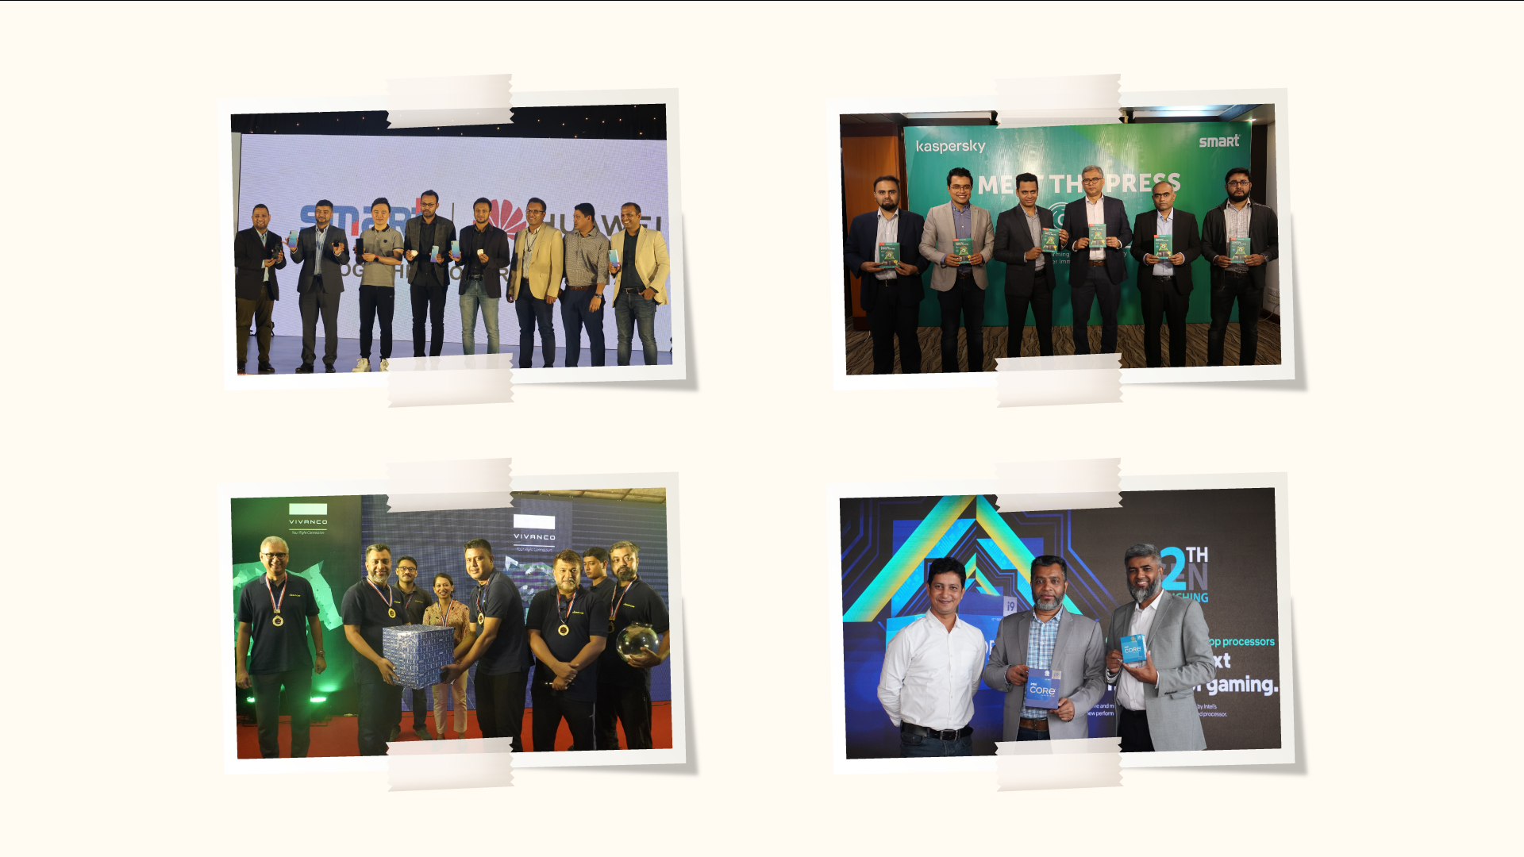

Slide 23

24X7 Call Center
SMART provides great technical talent and experience to all of our offices around the country to help clients with their support needs. We ensure that our technical employees can provide great service by providing ongoing training and maintaining their expert skills. This allows us to provide faster service turnaround times. Our rates for first-time service are among the best in the industry.

Slide 24
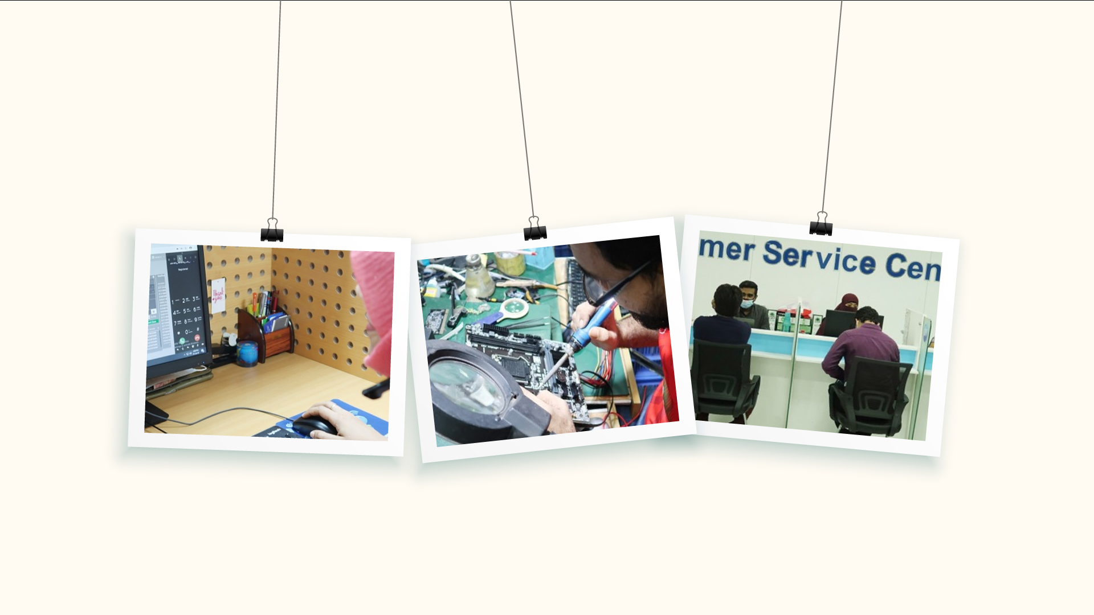

Slide 25

CORPORATE SOCIAL RESPONSIBILITY
TRANSPERENCY ON CORPORATE GOVERNANCE
FAIR BUSINESS AND MARKETING PRACTICES
GENDER EQUITY IN EMPLOYMENT
EMPLOYEE WELLBEING
ENGAGING IN CHARITY WORK THROUGH SMART FOUNDATION
REDUCING CARBON FOOTPRINT BY ENCOURAGING CLOUD SOLUTIONS

Slide 26
CONTACT
Address
Jahir Smart Tower 205/1 & 205/1/A, West Kafrul, Begum Rokeya Sharani, Taltola, Dhaka-1207.
Phone
+88 09678100500, 02-58153040 +8802-58153636, +8802-55025235.
Email
info@smartbd.com
www.smartbd.com

